Slide 1
Summary & Paraphrasing
Distinguishing between the author’s words and your reactions

Slide 2
The difference between…
Summary
When you want to cover just the main points of a large topic
Generally short and brief
Can be tailored to the needs of the writer
Paraphrasing
When you want to cover details as well as the main idea of a specific topic
Generally, but not always longer
Used to clarify a source’s idea, but in the language of the writer

Slide 3
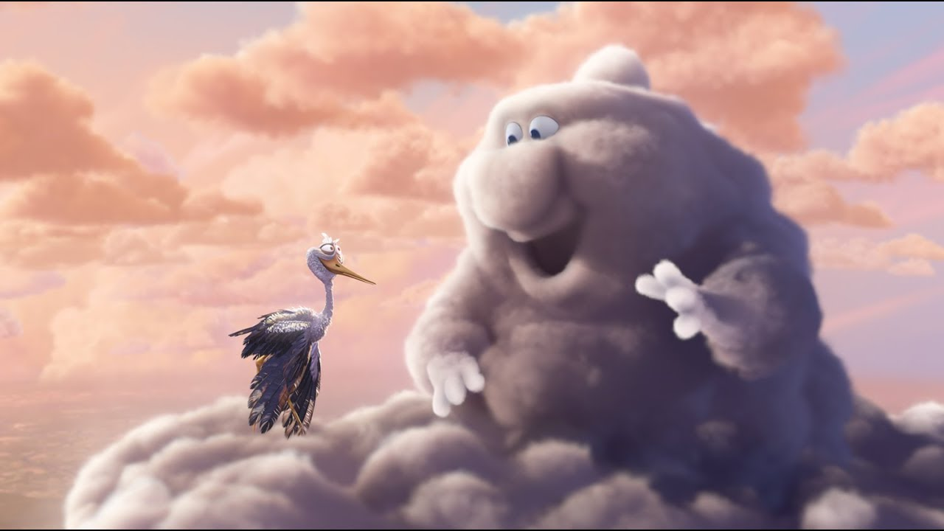
Watch “Partly Cloudy” excerpt: 1:30-2:20
What happens in this scene?
Can you describe the main idea in a single sentence?
How do you know it’s the main idea?
HINT:
A main idea should be a complete sentence
Noun + action + impact

Slide 4
Summarizing
Now, let’s watch the whole movie and see if that scene is still important to the main idea of the whole film.
What should the main idea of a film cover?
What parts does a story / movie have to have?
Stories always need a few things:
Characters
A normal worldview (exposition)
A conflict
A test, or a climax, which should resolve the conflict
And then a resolution telling us what the new normal worldview is
X wants Y, but Z is in the way.

Slide 5
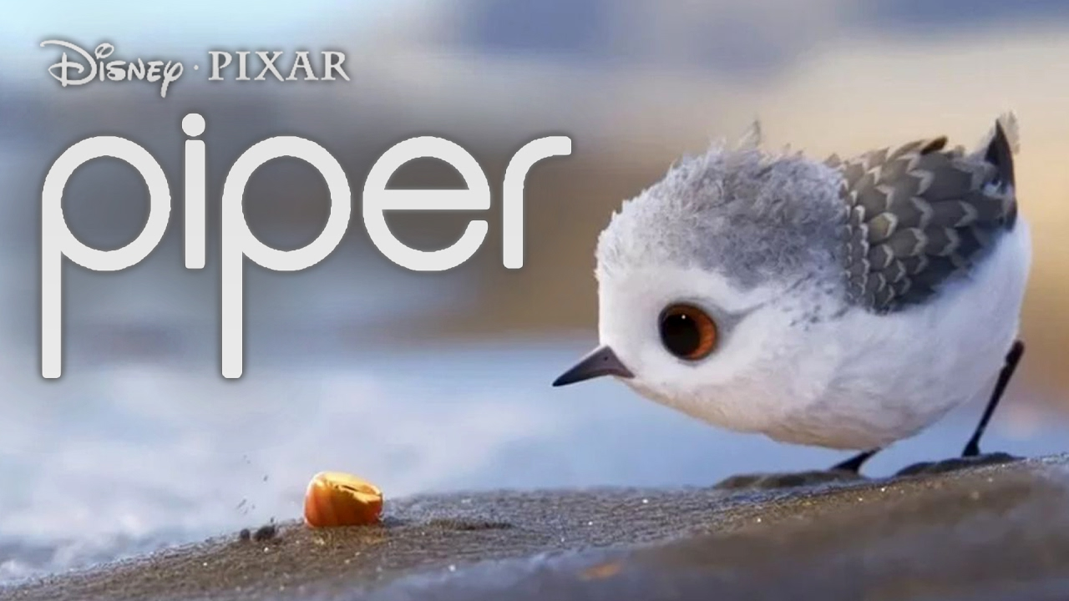
Needs of Summary = Needs of Genre
This format works for any story.
Watch Piper
But this same format works for any written, visual, or verbal genre**
Find out what type of genre you’re experiencing
Find out what major parts are needed in the genre
Identify those points in the text
And you have a summary
**a category of composition characterized by a particular style, form, or content

Slide 6
An Example Summary
The Pixar short, piper, tells the story of a baby sandpiper whose mother is trying to teach it how to feed itself. Piper’s first attempt ends with a crashing wave, and she quickly becomes afraid of the water. However, when piper sees how hermit crabs handle the waves, she finds new joy in the ocean.
Let’s see if we can condense that!
Character
Normal Worldview
Conflict
Test
Resolution
Piper is the heart-warming story of a baby bird who is afraid of the ocean, and has to learn to overcome her fears in order to catch food with the other birds.

Slide 7
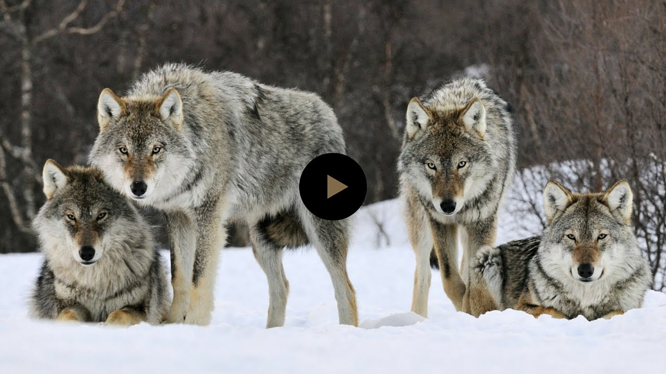
Next, let’s try an informational text “How Wolves Change Rivers”
This video is going to explain an effect. Take a minute to discuss what to expect from cause & effect essays

Slide 8
An Example Summary
“Widespread trophic cascades in Yellowstone National Park after the re-introduction of wolves to the ecosystem changed not only the behavior of animals and plants, but even the rivers.
We need to know
what the effect is,
what’s causing it,
and why it matters
Trophic Cascades an ecological process that starts at the top of the food chain, and tumbles all the way down to the bottom.

Slide 9
Now, let’s try combining the elements!
What are the expected elements of a commercial, or any form of advertising?

Slide 10
How was the SimpleHuman trashcan ad different than you expected?
First, list the parts of the video that did what you believe a commercial should do
Next, summarize the story in a sentence or two
Now see if you can combine those to summarize a narrative commercial.
It included a story! That’s actually pretty normal for commercials, we just don’t get invested in them very often, because they’re short.

Slide 11
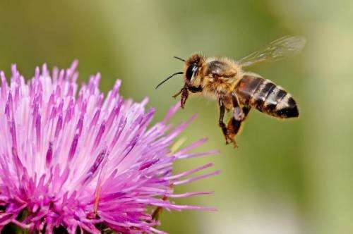
Here’s a written genre, more like your research for the class.
Click to Read Article
Try these three different summary prompts. How does your maid idea change?
Summarize how optical flow helps bees find their way home.
Summarize the laboratory experiment that researchers used to study how bees find their way home.
Summarize why researchers feels understanding bee’s navigation systems is essential to keeping them alive.
Notes:
Have the students read the linked short article. Then change the screen, or (if you printed) have the students turn the article over. Ask students to work with one of the following summary prompts. There are 3 (below). Don’t tell them they’re receiving 3 different prompts. The point of this exercise is to show them that there is no one single, correct, summary, but rather that summary must also serve the purpose of the reader/writer. Different prompts will require summarizing different parts of the article.
Summarize how optical flow helps bees find their way home.
Summarize the laboratory experiment that researchers used to study how bees find their way home.
Summarize why researchers feels understanding bee’s navigation systems is essential to keeping them alive.
Finally, have the students flip the article back over (or bring it back on the screen) and ask them to improve their summary with the help of the article, but without using the article’s words directly.
Ask for a few examples and discuss as a class.

Slide 12
Summary Quick Tips
Summary needs to serve the purpose of the reader.
Find out what you need to know, or what your audience needs to know, first
That, along with the goals of the genre, should guide your summary
Generally, paraphrasing is going to be longer, and include more details, but follows the same rules.
Both should be in your own words
Both require MLA documentation, which you can include with a signal phrase
According to a documentary by environmental engineer Chris Agnos, the reintroduction of wolves in Yellowstone national forest has helped create a trophic cascade that has supported both plant and animal life, as well as strengthened the river systems (Sustainable Human).

